Slide 1
The Universe: where does it end?
Chris North
Cardiff University

Slide 2
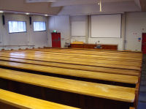
The speed of light
c = 299,792,458 m/s
or 670,616,629 miles per hour
or 2 million million furlongs per fortnight
or ~300,000 km/s
That’s fast, but how fast?
0.13 seconds
3 milliseconds
0.1 microseconds
1 nanosecond
Notes:
Sun & Moon
Nearest stars
Nearby galaxies

Slide 3
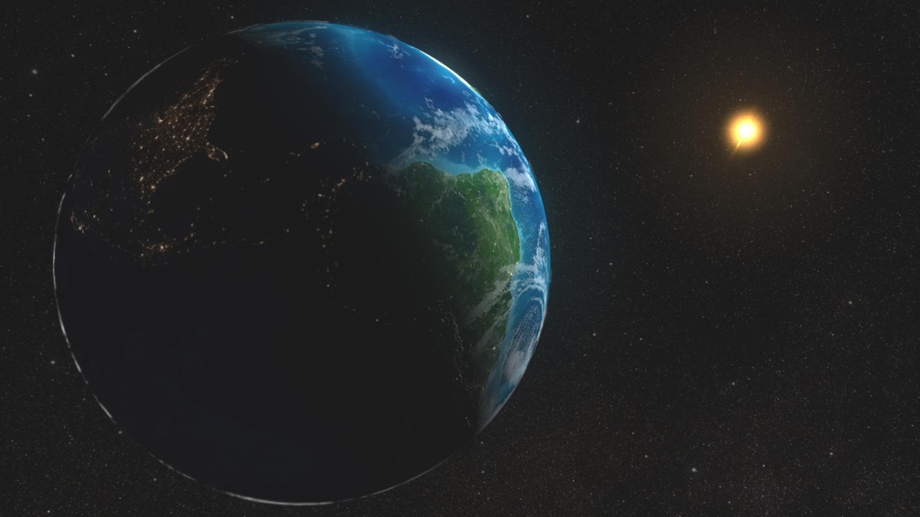
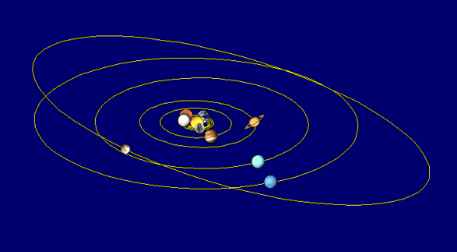
Light travel time
Light travels…
…to the Moon in 1.3 seconds
…to the Sun in 8.3 minutes
…across the Solar System in 8.3 hours
Notes:
Stars and galaxies
Speed of light

Slide 4
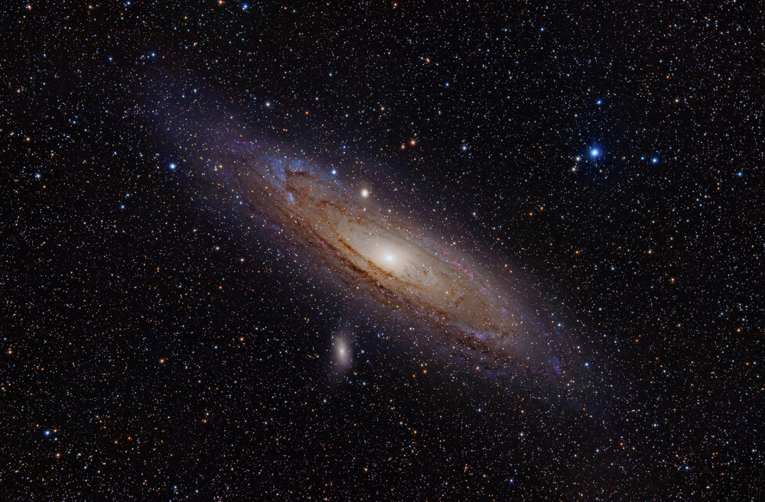
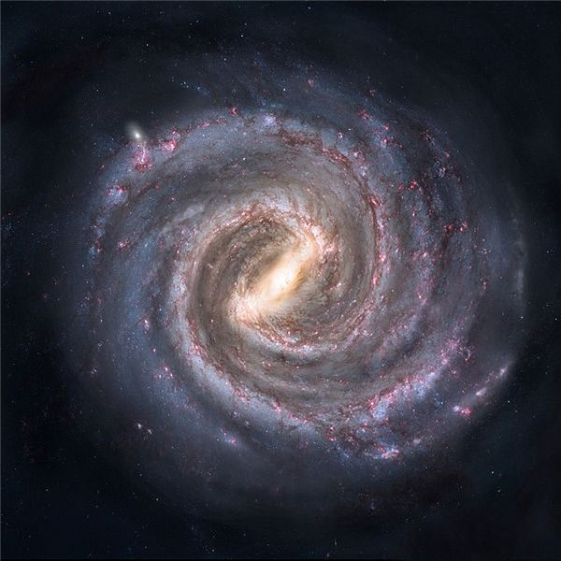
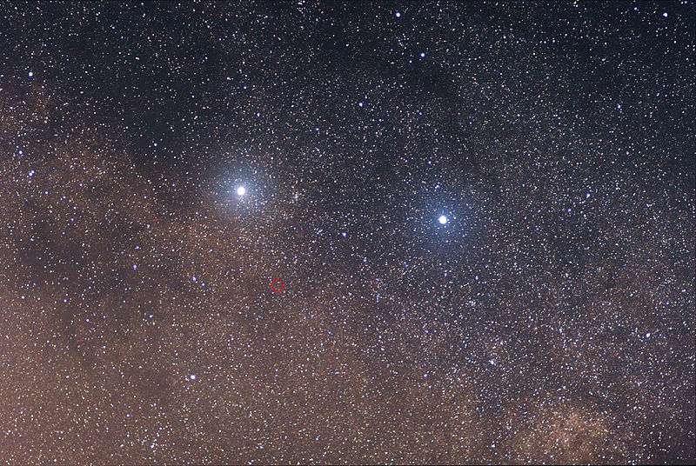
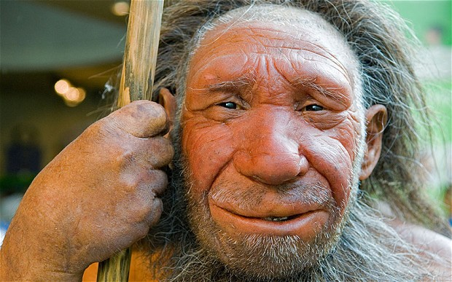
Light travel time
Light travels…
…across the Solar System in 8.3 hours
…to the nearest star in 4.24 years
…to the centre of the Galaxy in 30,000 years
…to the Andromeda Galaxy in 2.5 million years
Notes:
30,000 years ago: first domestic dogs, Neanderthals going extinct

Slide 5
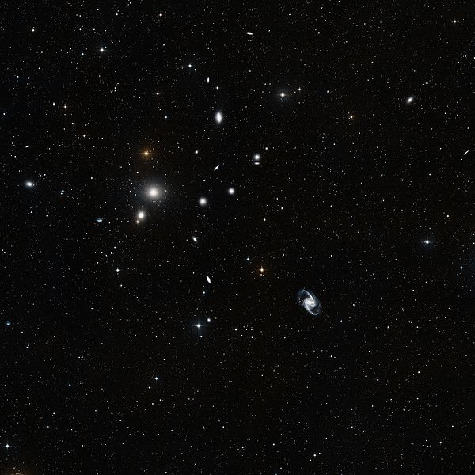
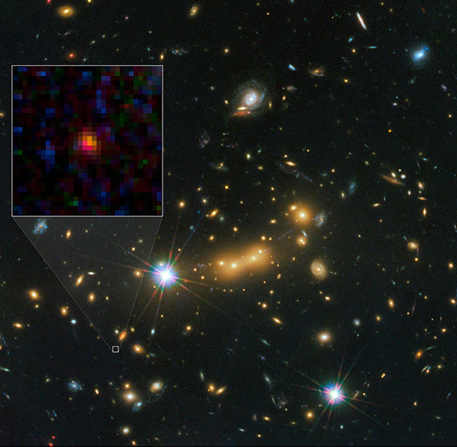
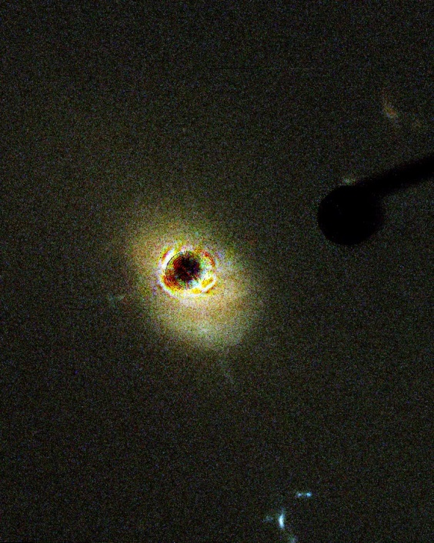
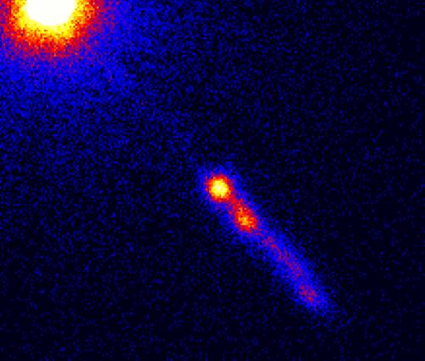
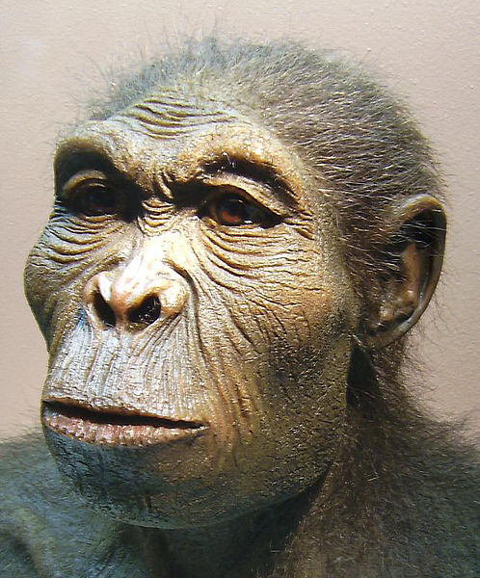
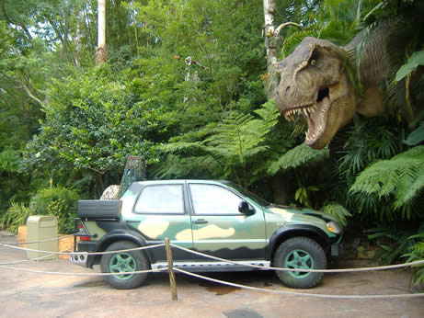
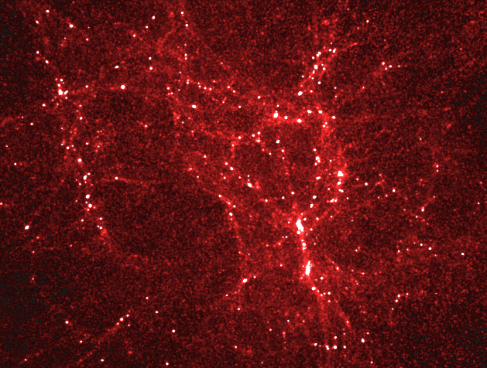
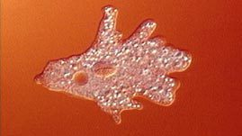
Light travel time
Light travels…
…to the Andromeda Galaxy in 2.5 million years
…to most distant galaxies in 13 billion years
…to a nearby “quasar” in 2 billion years
…to the Fornax Cluster in 65 million years
Notes:
2.5 million years ago: split from chipmanzees
65 million years so: dinosaurs

Slide 6
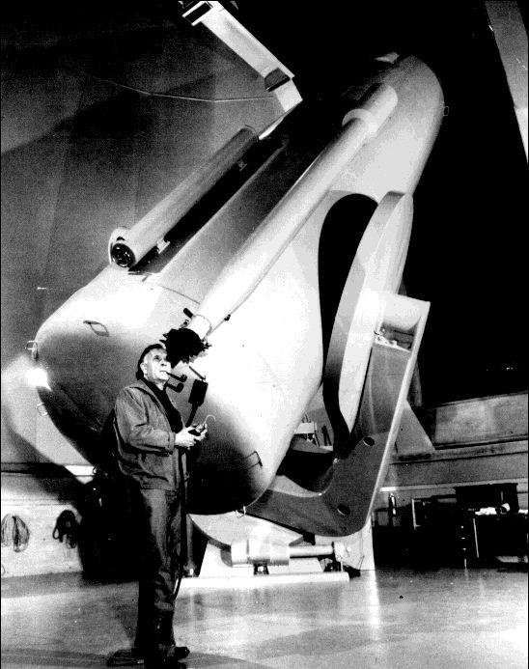
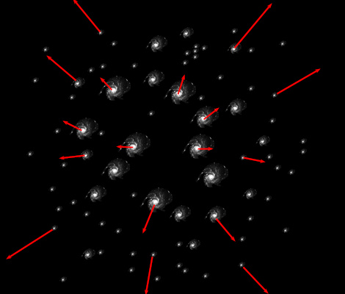
Expanding Universe

Slide 7
Hubble’s Law
Fornax Cluster
3C 273
Distant Galaxy
65 million years
2 billion years
13.4 billion years
1400 km/s
54,000 km/s
690,000 km/s
0.005 c
0.18 c
2.2 c
1.004 x
1.158 x
12 x

Slide 8
Hubble’s Law
Fornax Cluster
3C 273
Distant Galaxy
65 million years
2 billion years
13.4 billion years
1.004 x
1.158 x
12 x
1400 km/s
54,000 km/s
690,000 km/s
0.005 c
0.18 c
2.2 c

Slide 9
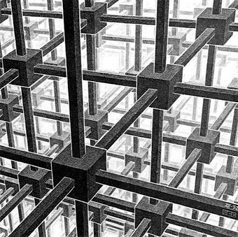
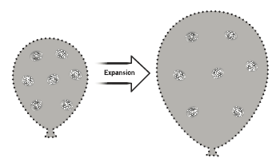
The Expanding Universe

Slide 10
The Expanding Universe

Slide 11
The Expanding Universe

Slide 12
The Expanding Universe

Slide 13
The Expanding Universe

Slide 14
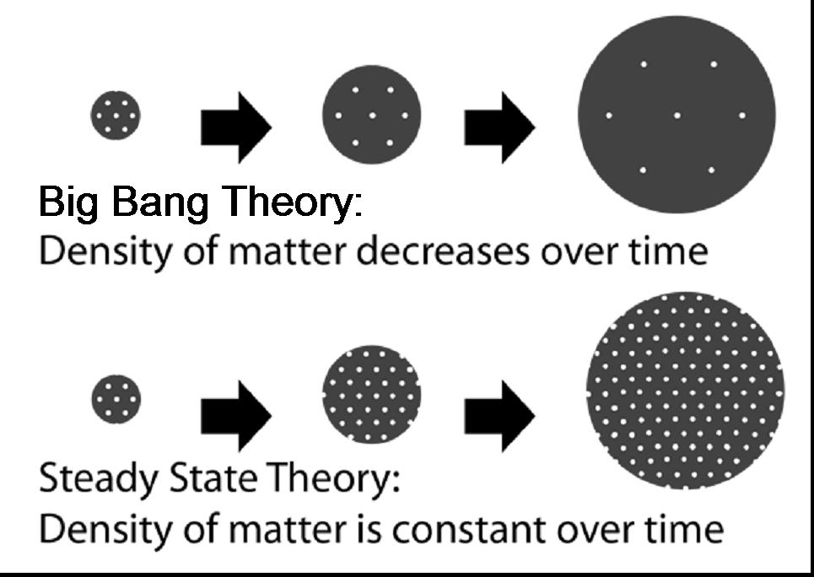
Steady State vs Big Bang

Slide 15
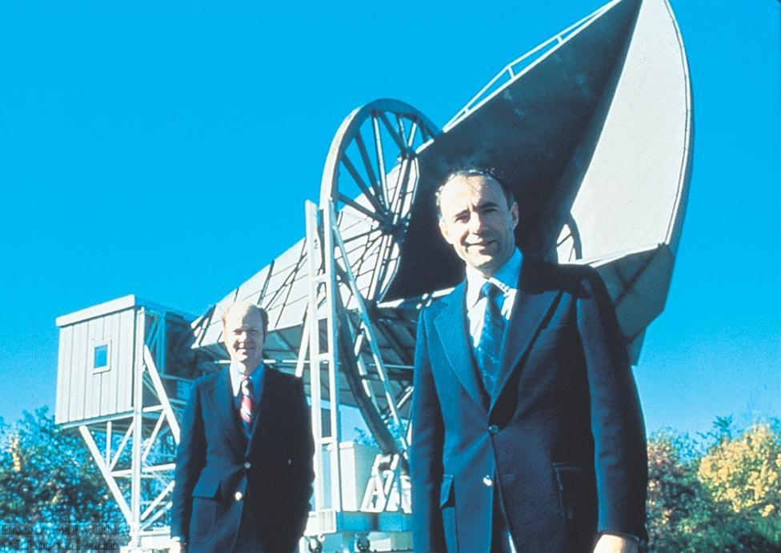
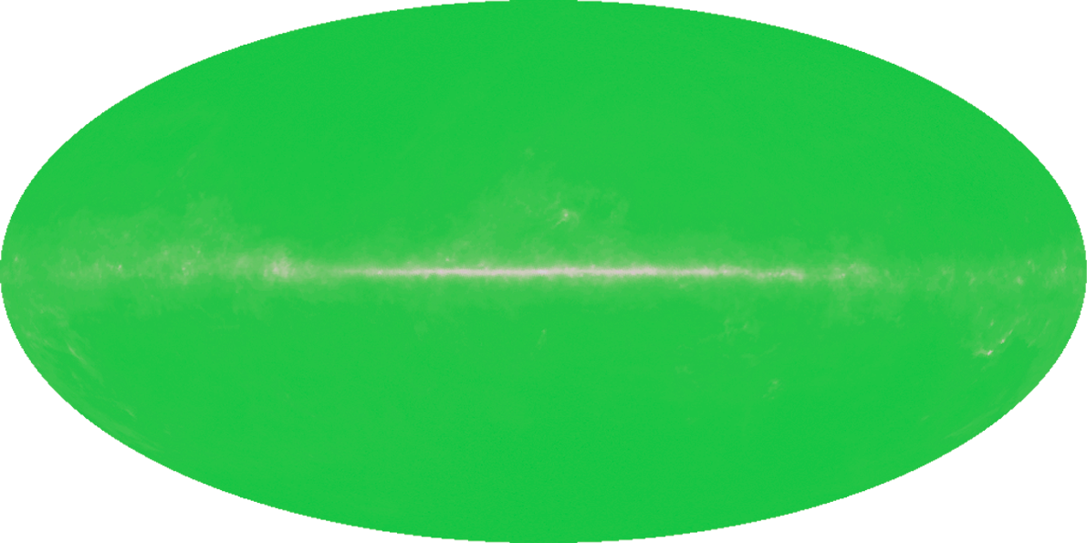
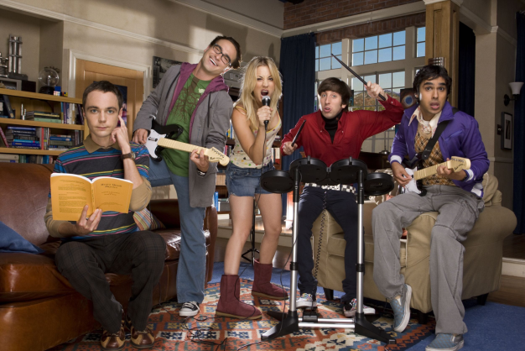
The nail in the coffin
Notes:
Analogue TV!!!

Slide 16
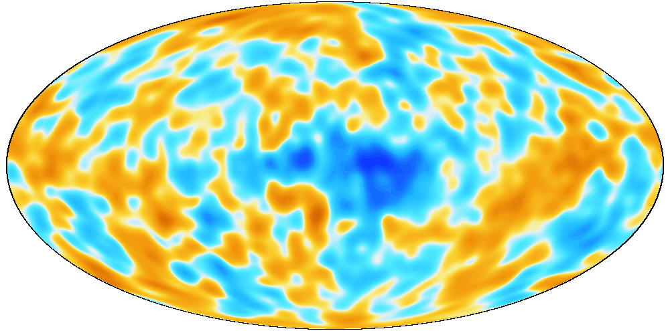
The nail in the coffin
Notes:
Analogue TV!!!

Slide 17
The cosmic horizon
Notes:
Horizon Problem
Flatness Problem

Slide 18
Fate of the Universe
Low density
Size
Critical density
High density
Time
Critical Density: 6 hydrogen atoms per cubic metre

Slide 19
Universal composition (1800)
Stars
Density: 0.025 hydrogen atoms per cubic metre
(0.004 x critical density)

Slide 20
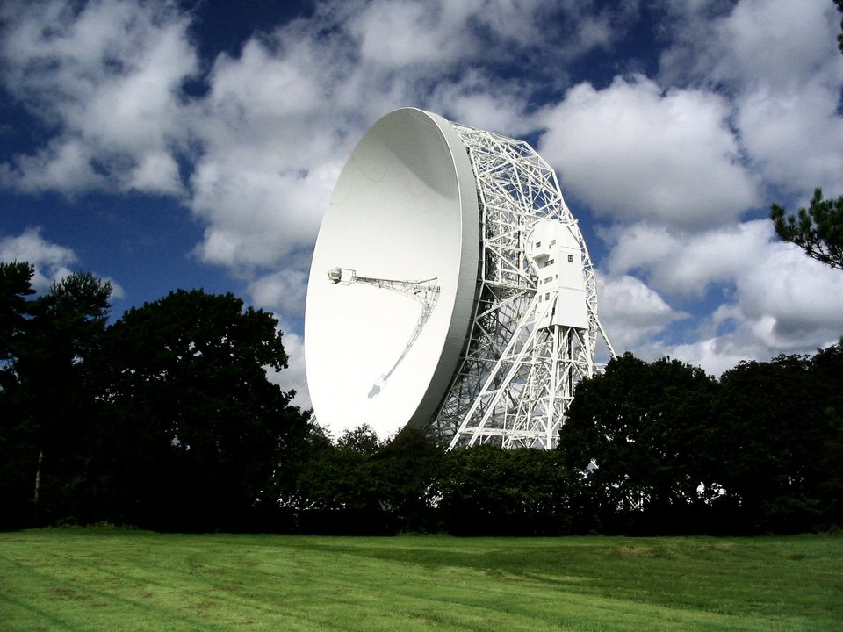
Universal composition (1950)
Density: 0.25 hydrogen atoms per cubic metre
(0.04 x critical density)

Slide 21
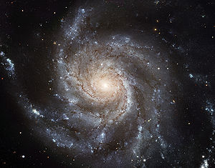
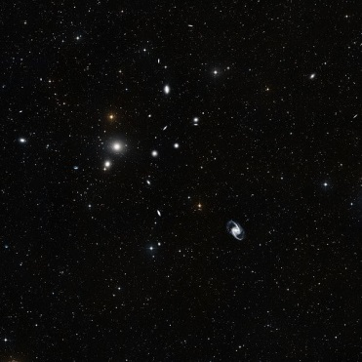
Universal composition (1960)
Density: 1.33 Hydrogen atoms per cubic metre
(0.2 x critical density)

Slide 22
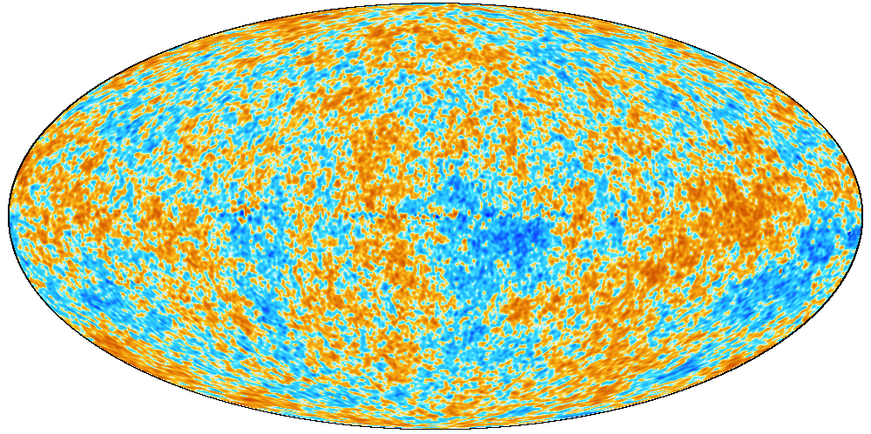
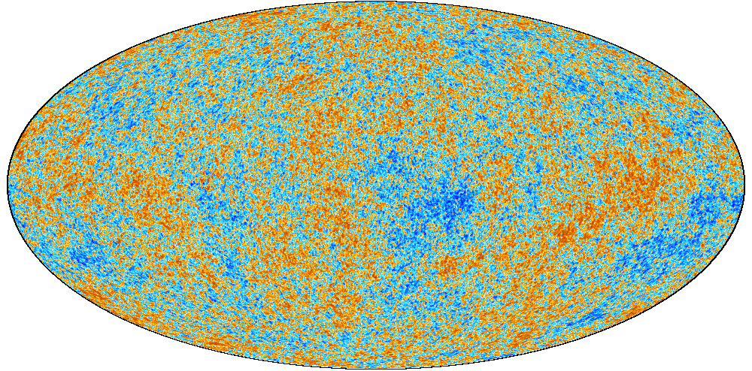
Cosmic Microwave Background
1965
1992
2001
2013
Notes:
Analogue TV!!!

Slide 23
Universal composition (now)
Density: 6 hydrogen atoms per cubic metre
(1.00 x critical density)
Notes:
Measuring Universe flatness
Demo with different triangles

Slide 24
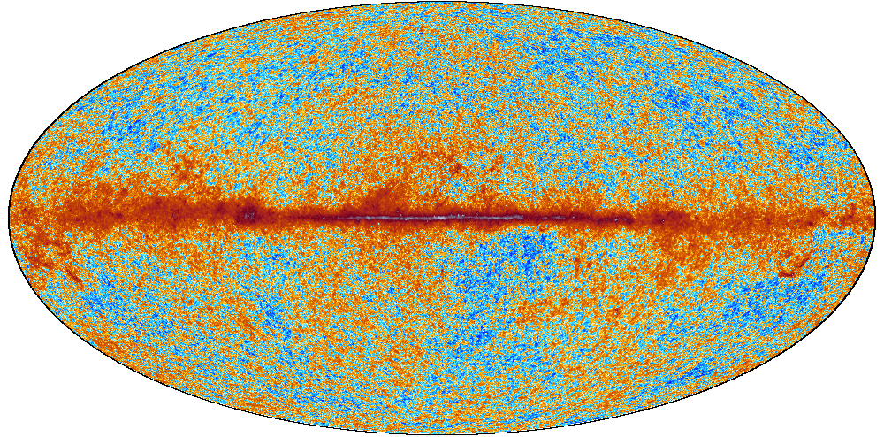
Geometry of Space

Slide 25
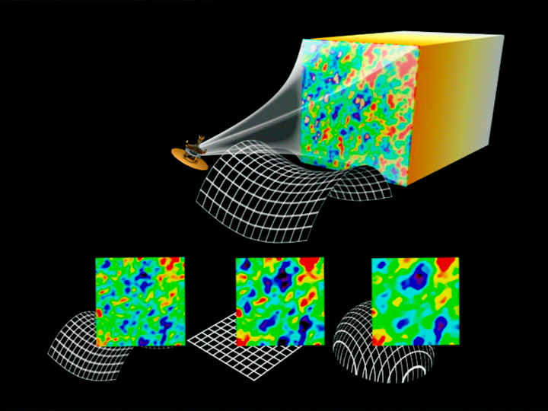
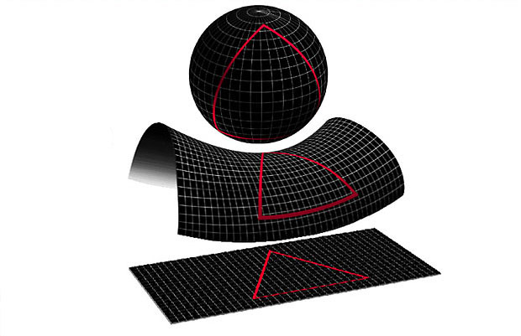
The Geometry of Space
Notes:
Average density of space (6 hydrogen atoms / cubic metre)

Slide 26
The Horizon Problem

Slide 27
The Horizon Problem
Sphere of influence
CMB
Our Horizon
CMB
CMB
CMB

Slide 28
Inflation: the solution
Notes:
Bl

Slide 29
Fate of the Universe
Low density
Observed
Size
Critical density
High density
Time

Slide 30
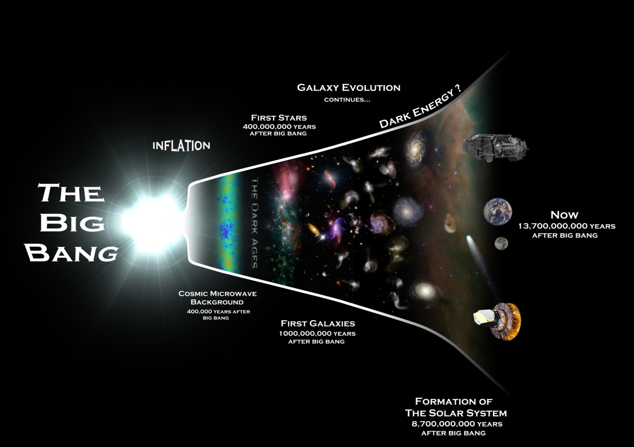
Remaining questions
What caused the Big Bang?
What is inflation?
What is dark matter?
What is dark energy?
Notes:
What was inflation?
What is Dark Matter?
What is Dark Energy?

